Slide 1

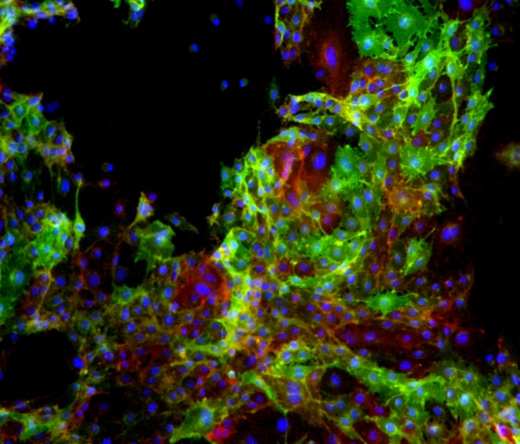
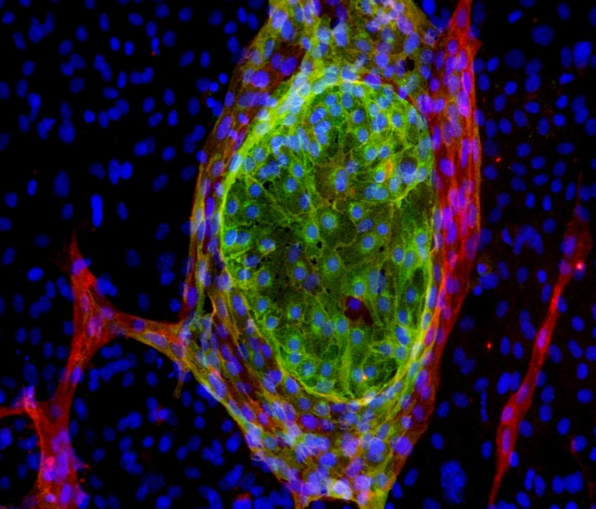
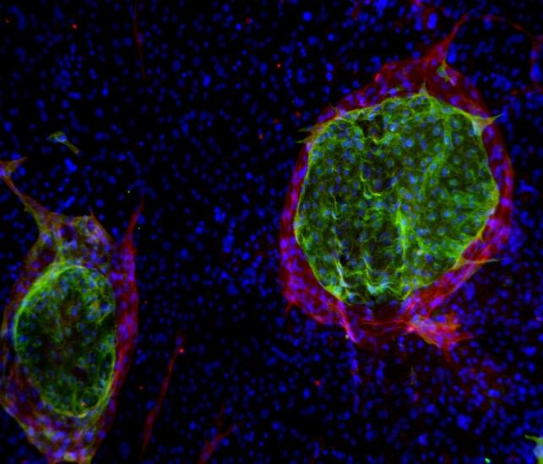
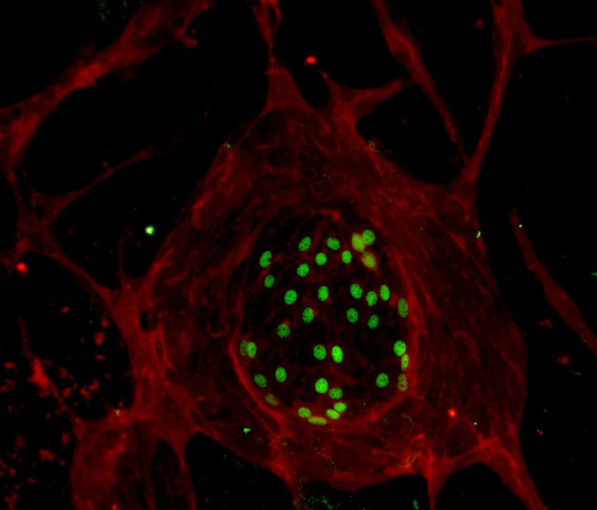
Reliatech GmbH
Anti-human CD31 / anti-human LYVE-1
(Cat #101-M92 / #102-PA50)
CD31
LYVE
DAPI
CD31
LYVE
DAPI
Fig. 1: Immunofluorescence staining of human CD31 (red) and LYVE-1 (green) in freshly isolated human microvascular endothelial cells from skin.
Isolation 26.10.07
Isolation 5.11.07
CD31
LYVE
DAPI
CD31
Prox
DAPI
Isolation 5.11.07
Isolation 5.11.07
http://www.reliatech.de / orders@reliatech.de

